Slide 1
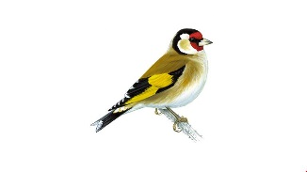
Welcome to Year 2 A very warm welcome to all our parents from the Year 2 team. Skylarks- Miss Davies and Mrs Foster Ms. English, Mrs Wheeler, Mrs Pacey and Mrs Kent Goldfinches- Mrs. Hines and Ms. Bush Mrs King Ms. Bush will cover leadership time on a Wednesday afternoon. Ms Bush and Premier Sport will be covering PPA for both classes on a Wednesday afternoon.

Slide 2
Coronavirus Precautions
Increased handwashing – children will be expected to wash / sanitise their hands every time they enter and leave the classroom.​
There is a staff rota for cleaning toilets, contact points and classrooms regularly, during the course of the day, additional to normal cleaning.​
No whole-school assemblies at present. For now, we will have class and year group assemblies.​ We may plan whole school events but these will be through zoom in our separate classrooms for the foreseeable future.
Celebration assembly on a Friday takes place as a key stage over Zoom.

Slide 3
Coronavirus Precautions
Children to have their lunch in the hall.
FLASH for Y2 will take place in Skylarks class.
Both year 2 classes will constitute as one bubble; they can work, play and socialise without the need for social distancing. However, following the DfE guidance, physical contact will still be discouraged.

Slide 4
Preparing the children for learning in Year 2
We expect the children to be independent and to be able to organise:
Reading folder/reading record books
Water bottle
Fasten own clothing. Please do not provide children with lace up shoes if they are unable to tie their laces.
Long hair should be tied back
Stud earrings covered with tape or removed for PE days
Homework and letters
Label everything (fabric labels if possible)
Please leave your child at the gate every morning at 8.55am.
If you need to speak with us, it is best to arrange a telephone call via the office.

Slide 5
Bringing Equipment into School
Please limit the amount of equipment the children bring into school.
Children can bring in their own named, small bottles of hand sanitiser.
Children need to come into school on a Monday and a Wednesday wearing suitable PE kit.
Please detach items such as key rings from school bags and book bags.
No stationery needs to be sent in. We will provide all of this for the children.
Named water bottles need to be sent in and taken home each day.

Slide 6
Time | Lesson
8.55-9.10 | Registration, morning work and book changing.
9.10-9.45 | Guided reading and phonic intervention
9.45-10.15 | English
10.15-10.40 | Playtime
10.40-10.45 | Fruit time
10.45-11.45 | Maths
11.45 – 12.25 | Lunch time
12.25 – 1.00 | Spelling and handwriting
1.00 – 2.00 | Topic/Science/ICT PE/Music/RE/PSHE/
2.00 – 2.20 | Playtime
2.20 – 2.45 | Topic/Science/ICT PE/Music/RE/PSHE/
2.45 – 3.05 | Assembly/story (in year group bubble)
3.10 | Hometime

Slide 7
Our curriculum

Slide 8
Reading in Year 2
Reading continues to be at the heart of the English curriculum.
Reading Record Books – need to be brought in to school every day.
Please keep the record books in the clear plastic zip folder (cardboard folders may be used initially)
The children can have either one chapter book or two picture books for up to two weeks.
Books will be changed once a week on the same day each week.

Slide 9
Reading in Year 2
Please listen to your child read for at least 15 – 20 minutes most days.
Guided reading with the teacher or teaching assistant will take place at least once a week.

Slide 10
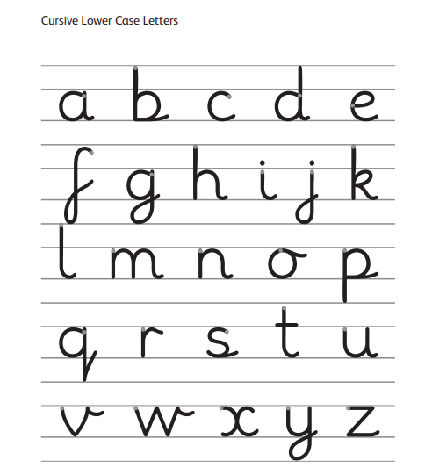
English
Spellings
We will start off by revisiting some of the Phase 5 phonemes and year 1 spelling objectives from the summer term.
Topic words
Handwriting
Cursive letter join
Phonics
Children will do the phonics screening check in the second half of the autumn term.

Slide 11
Writing

Slide 12
Mathematics
Some year 1 summer objectives will be revisited.
2, 5 and 10 times tables
Place value
Addition and subtraction
Multiplication and division
Cross-curricular maths

Slide 13
Mathematics
Information for supporting your child at home is on our school website including the calculation policy.
Parents – homework help – helping at home with maths
http://www.thebellbird.cambs.sch.uk/homework-help/

Slide 14
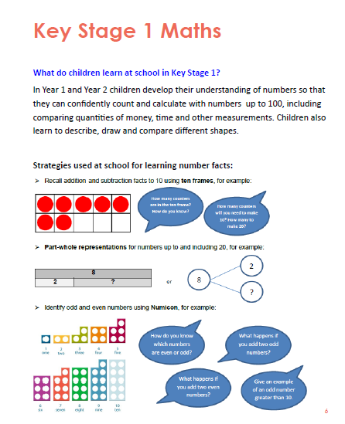

Slide 15
PE
Monday and Wednesday
Children to come into school on these days in their PE kit.
PE kit needs to be in the school colours. Suitable footwear is necessary.
Swimming in the summer term
Long hair tied back and earrings removed or covered up
Avoid laces!

Slide 16
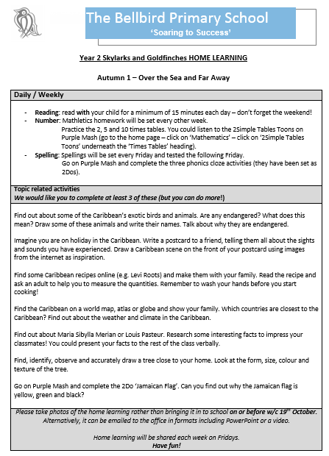
Home Learning
Spellings

Slide 17
Any Questions?
Thank you for attending this meeting and we look forward
to an exciting year ahead!
The home learning tasks, topic web and this presentation will be on the school website.
If you have any questions please e-mail the office and we will create a FAQ page that will be made accessible to parents following the meeting.

